Slide 1
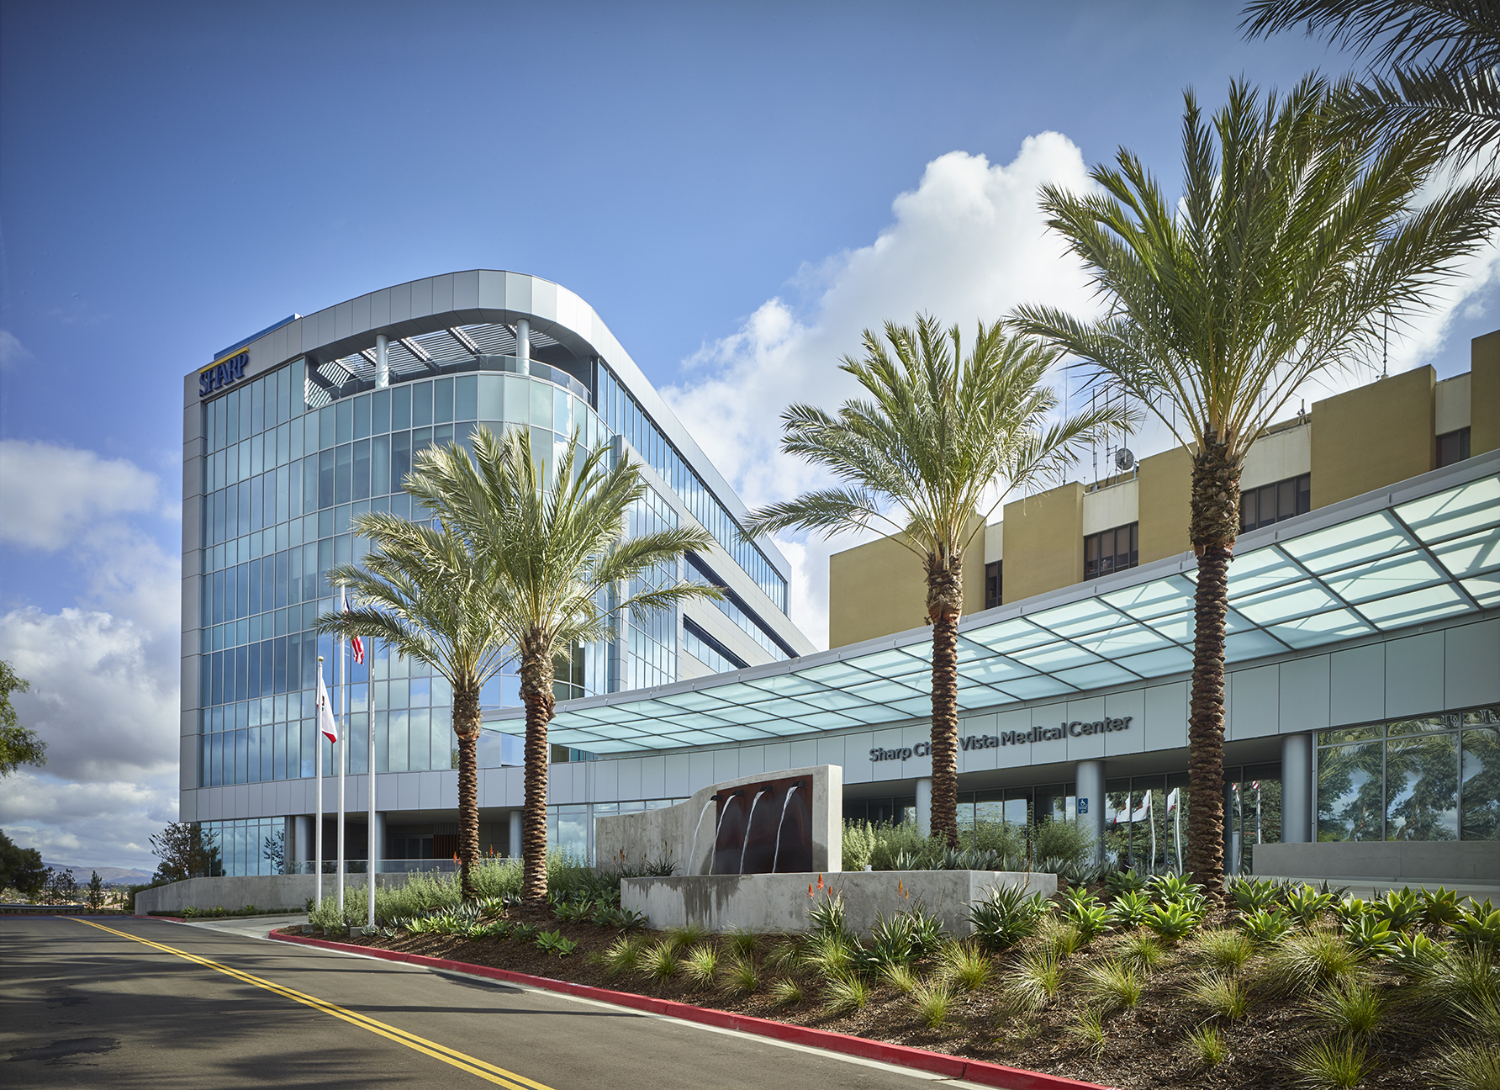
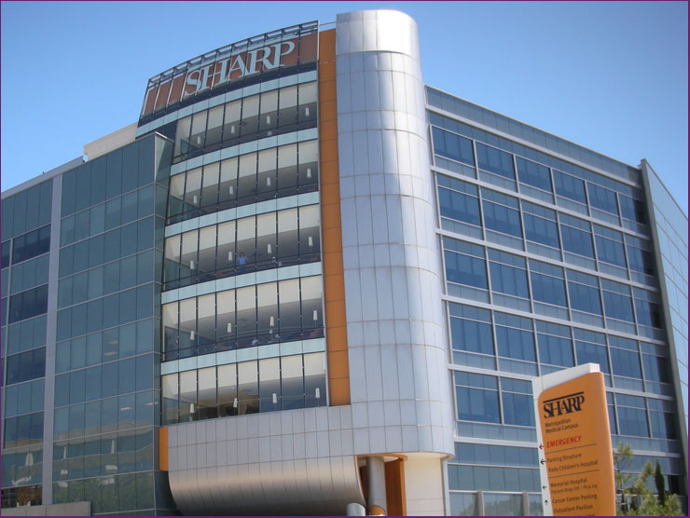
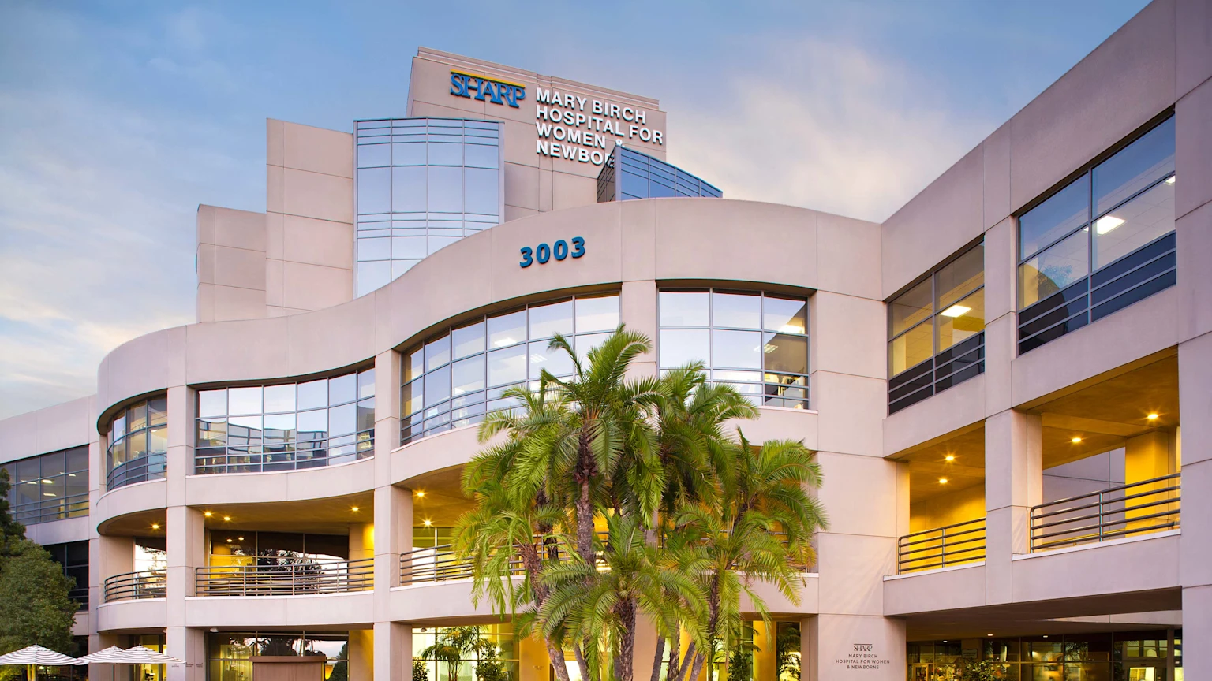
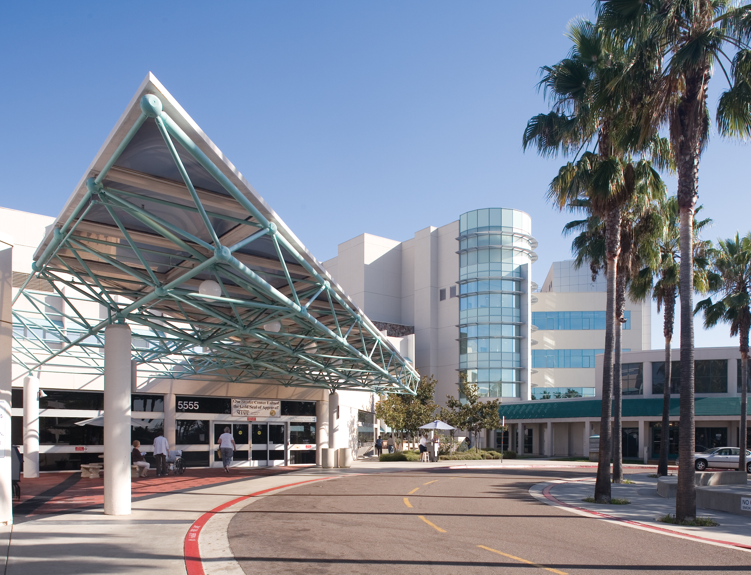
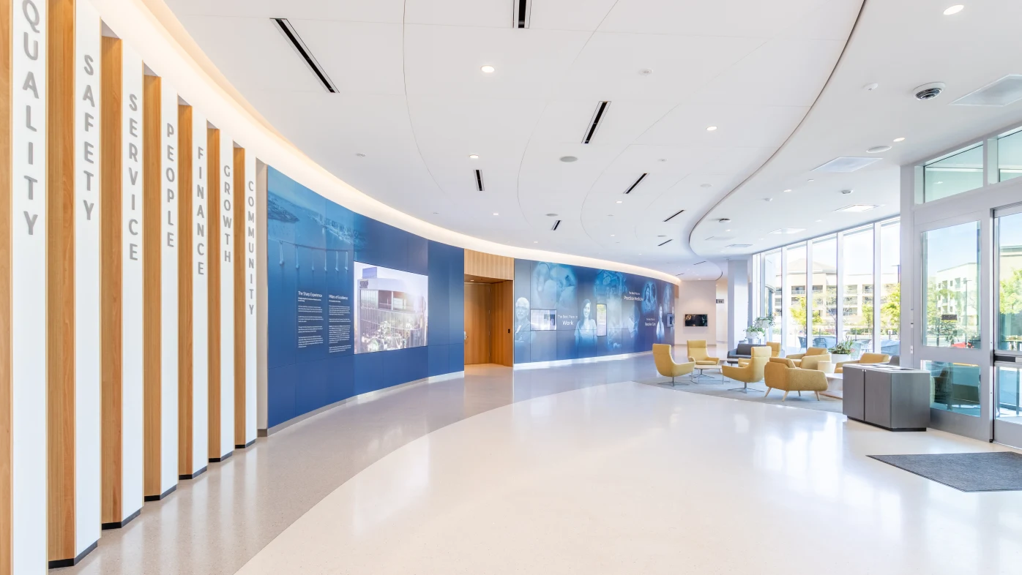

Sharp HealthCare
Tri-City Healthcare District
October 30, 2025
Christopher D. Howard, FACHE
President and CEO
Sharp HealthCare

Slide 2

“Partnership is not a posture but a process – a continuous process that grows stronger each year as we devote ourselves to common tasks.”
John F. Kennedy

Slide 3
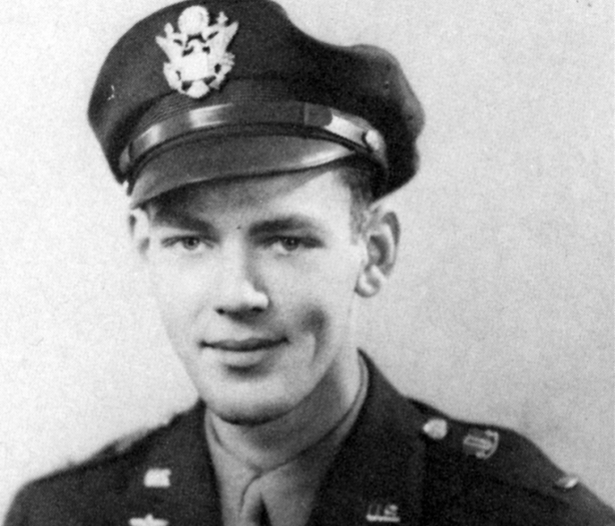
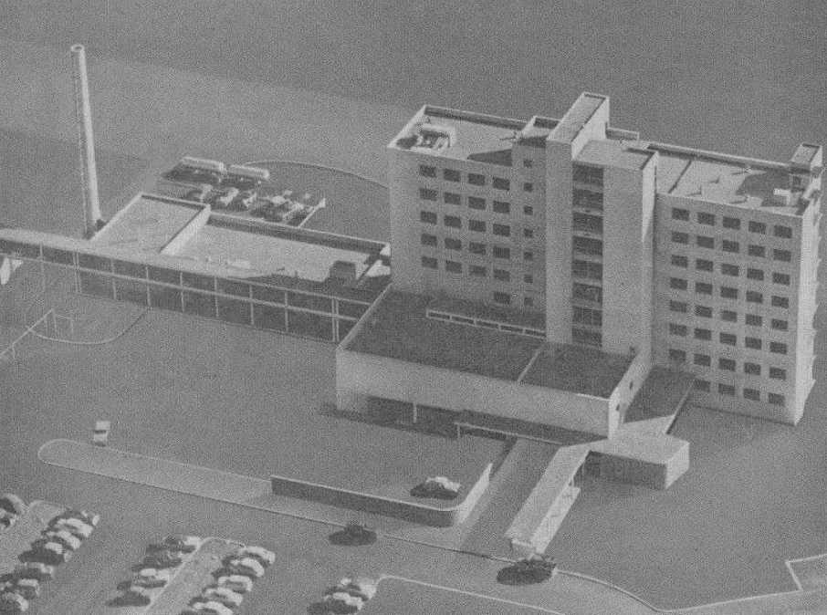
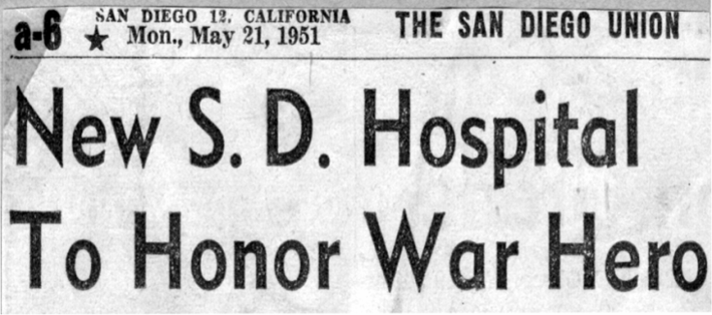

Our Story
Donald N. Sharp Memorial Community Hospital opens as a nonprofit, nonsectarian charitable institution providing general care for the people of San Diego.
Dedication
1955

Slide 4

Historical System Growth
1991: Grossmont Hospital Corporation and Grossmont Hospital Foundation
1989: Sharp Community Medical Group
2021: Sharp Freestanding Surgery, LLC
1992: CQIC
1994: Sharp Coronado Hospital
1981: Sharp Cabrillo Hospital
1955
1985: Sharp Rees-Stealy Medical Group
1992: Sharp Mary Birch Hospital for Women & Newborns
1998: Sharp Mesa Vista and Sharp McDonald Center
2016: SharpCare Medical Group
2025: Sharp Grossmont Hospital for Neuroscience
1979: Sharp Foundation
1989: Sharp Chula Vista Medical Center
1992: Sharp Health Plan
Notes:
CJ, 1/13/25: Sharp Freestanding Surgery, LLC was formed in 2021.
CJ, 1/23/18: Removed mention of Pioneer ACO (in 2012) and did not add NGACO, given the timing of where we are with the NGACO termination.

Slide 5


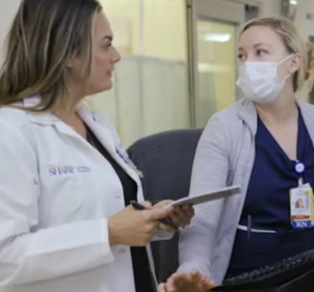
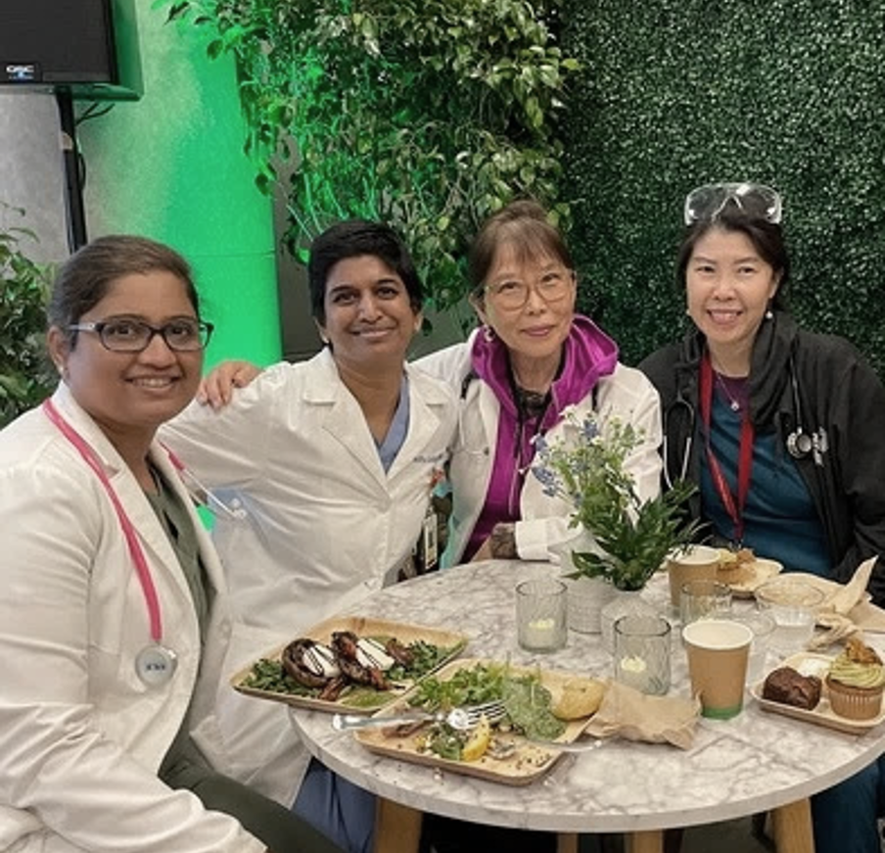
The Sharp Experience
The Best Place To Work
The Best Place To Practice Medicine
The Best Place to Receive Care

Slide 6
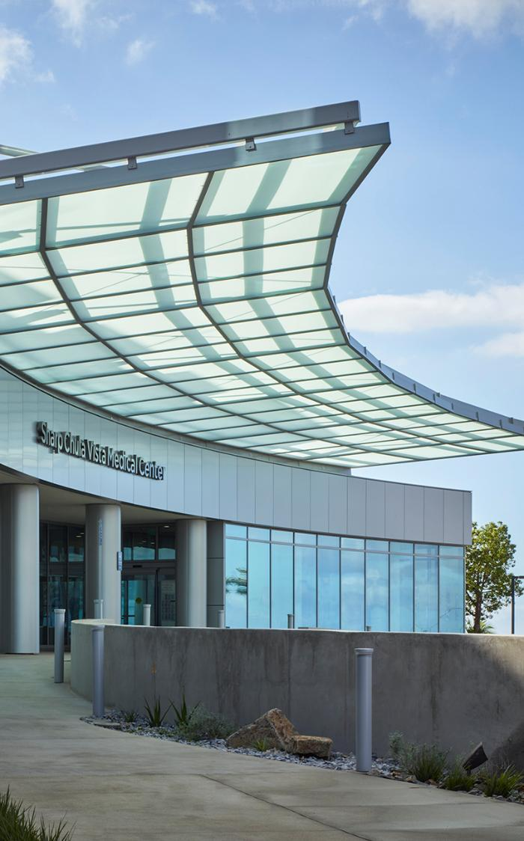
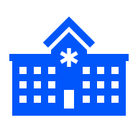
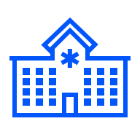




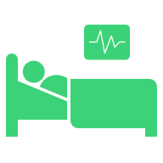



Sharp HealthCare Overview
4
acute care hospitals
4
specialty hospitals
3
primary care
medical groups
1
health plan
3.3 million
population served
>2,800
affiliated physicians
on medical staffs
2,106
licensed beds
>20,000
employees
>1,800
volunteers
#1
market share leader
in San Diego County
Notes:
Sources:
Sharp HealthCare Editorial Style Guide (SHC physicians, employees, volunteers; accessed via sharpnet.sharp.com 10/31/2024)
2024 SGH Market Assessment (SHC population served, accessed 10/31/2024)
2022 Sharp HealthCare Community Health Needs Assessment
Sharp Marketing
Sharp HealthCare Credentialing Department
Change Log:
4 specialty hospitals, per press release dated 7/16/2025

Slide 7
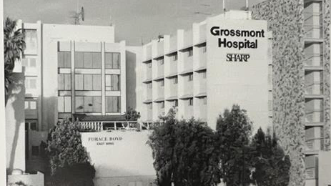
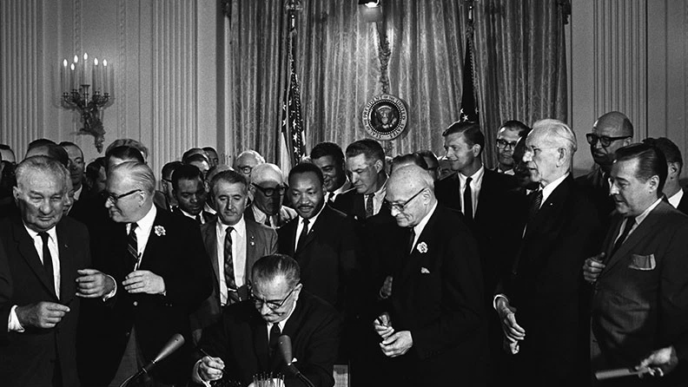
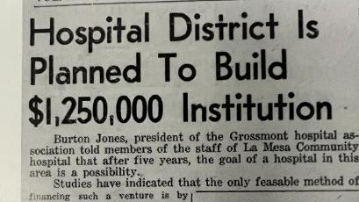
A Brief History Sharp Grossmont Hospital and Grossmont Healthcare District

Slide 8


Grossmont Healthcare District
The Grossmont Healthcare District was established in 1952 as the Grossmont Hospital District to be the vehicle for building a hospital to address the unmet healthcare needs of the rapidly growing East County communities
In a special election held on January 8, 1952, the residents of East County San Diego overwhelmingly voted Yes with 78.8% affirmative vote to establish the Grossmont Hospital District
The new district quickly got to work raising funds for the hospital allowing the district to construct a 100-bed hospital
Yes with 78.8% affirmative vote

Slide 9

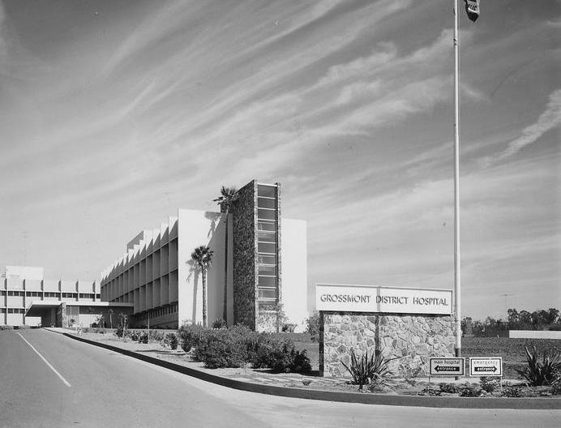
Grossmont District Hospital
Grossmont Hospital is community owned since 1955. It is funded by taxpayers with municipal oversight provided by the Grossmont Healthcare District. The hospital and district have a strong history of providing excellent care and leading the way in healthcare leadership
Originally built to serve a community of 70,000 residents, by 2024, this has grown to 883,251 with a service area encompassing 750 sq. miles
The hospital is a pioneer in cutting-edge medical procedures, while remaining responsive to its district’s needs, growing its capacity and services through the years
By 1956, the hospital’s success inspired many leaders around and beyond San Diego. The hospital’s architecture was noted for its design, and the public hospital district structure was lauded as a successful model of governance
Notes:
Third bullet: GHD success inspired others. In 1957, tri-city was formed. More correlational less causal

Slide 10

Formation
In 1991, the Grossmont Hospital District and Sharp HealthCare entered a lease agreement for operational purposes: Grossmont Hospital Corporation is formed
Elected Grossmont Hospital District Board of Directors would oversee the ownership and stewardship of the hospital
Sharp HealthCare would oversee the operations and management of the hospital, with a service area of over 750 square miles

Slide 11

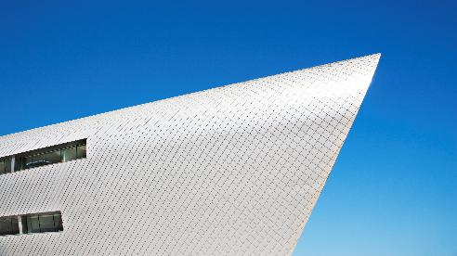
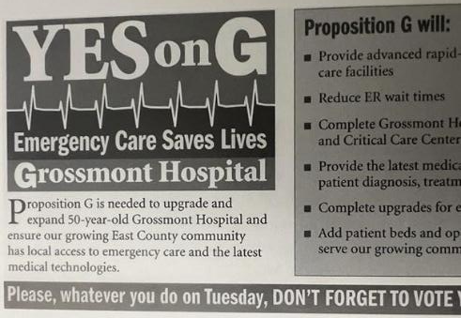
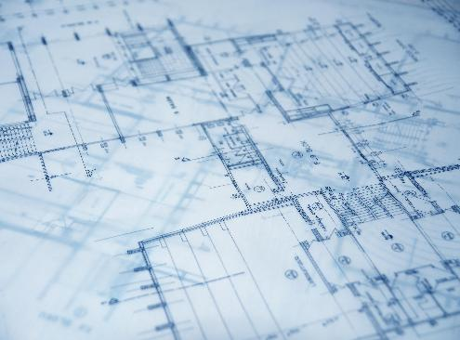


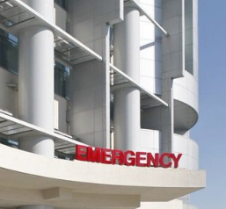
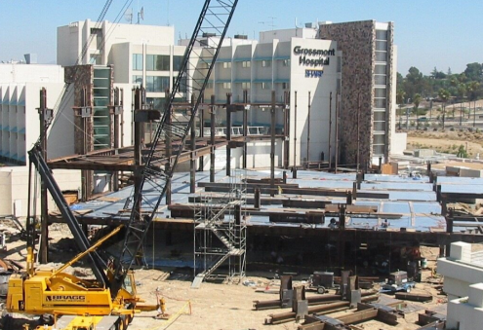
Proposition G
in 2006
Sharp HealthCare and Grossmont Healthcare District partnered to place Proposition G on the ballot in 2006 as a general obligation bond measure for more than $247 million in financial improvements for Sharp Grossmont Hospital
The measure passed with a 77.8% affirmative vote, and would bring numerous improvements to Sharp Grossmont Hospital to prepare it for the next decades of caring for East County San Diego

Slide 12
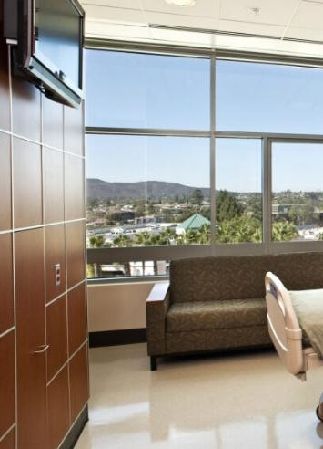
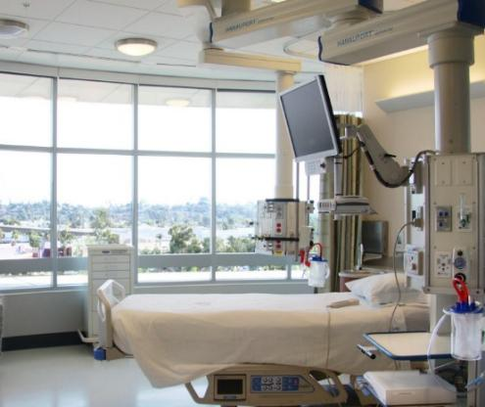
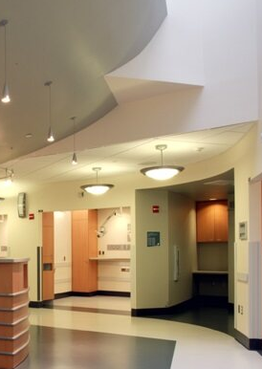
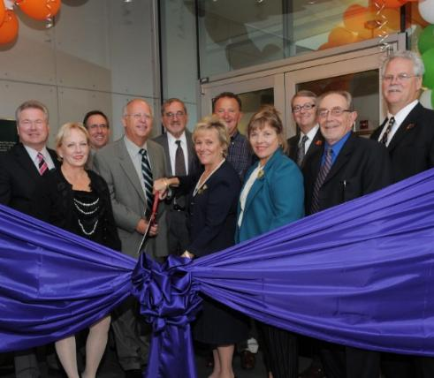
Expansion
The funds from Prop G allowed for the 2009 expansion of the Emergency and Critical Care Centers (West Tower) and renovation of the 1970s Acute Care Tower (East Tower)
The SGH Emergency Department would grow to be one of the state’s busiest by the 2010’s, surpassing 100,000 annual visitors by 2017
Notes:
Opening of west
Renovation of east
Opening of H&V
Brady Co-Gen
“acute care tower” – is east

Slide 13
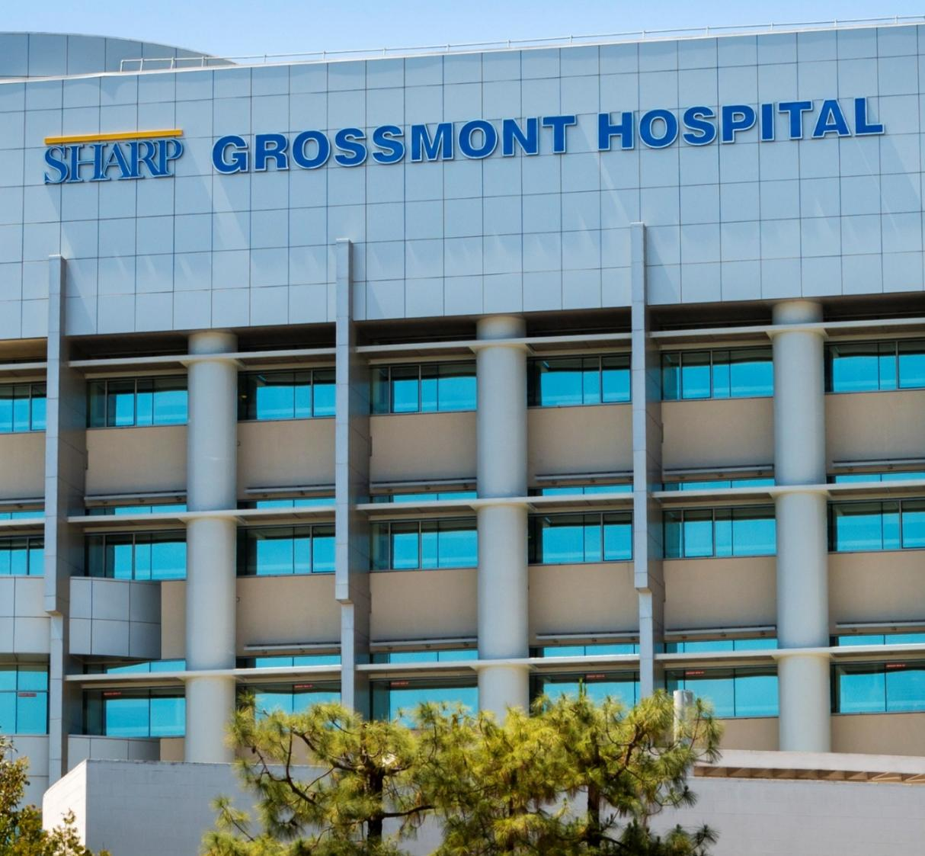
Proposition H in 2014
In an unopposed measure, Proposition H
overwhelmingly passed in 2014 to continue the partnership between Grossmont Healthcare District and Sharp HealthCare.
The ballot passed with an 87% affirmative vote to extend the hospital’s lease for an additional
30 years to 2051.
Notes:
Opening of west
Renovation of east
Opening of H&V
Brady Co-Gen
“acute care tower” – is east

Slide 14
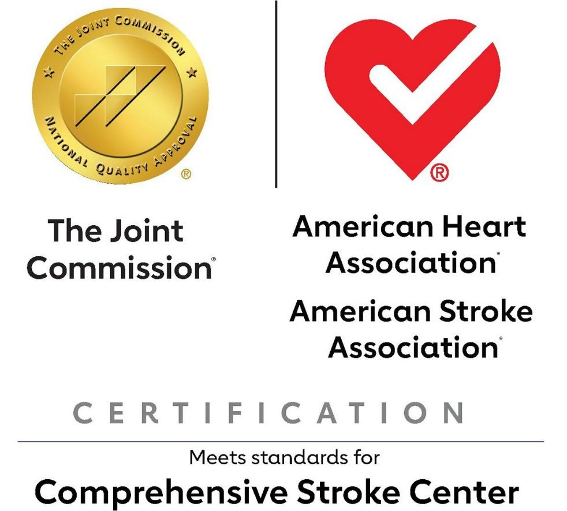
Comprehensive Stroke Center
Sharp Grossmont Hospital’s journey in excellence in neurological care passed a significant milestone in 2020 with the hospital’s designation as a Comprehensive Stroke Center – the first in East County San Diego and the first for Sharp HealthCare

Slide 15
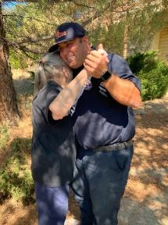
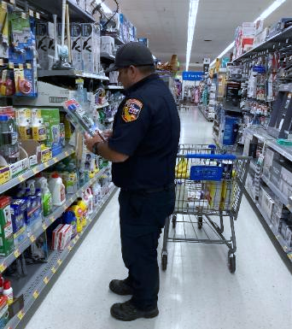
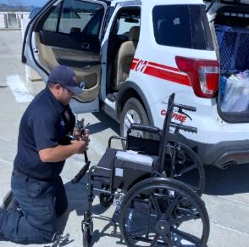

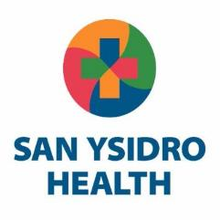
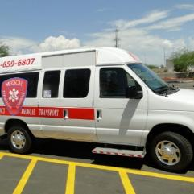
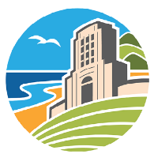
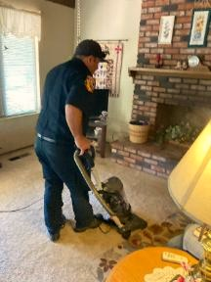
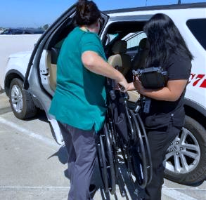
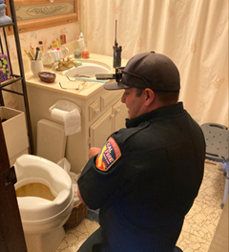
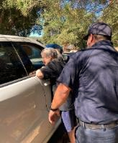
Community Health Initiatives & Collaborative Programs
Sharp Grossmont Hospital, Grossmont Healthcare District and local organizations collaborate on innovative programs for East County such as the Skilled Nursing Collaborative in 2016, Rural Health Discharge Program in 2023, and Transfer of Care Collaborative in 2023

Slide 16
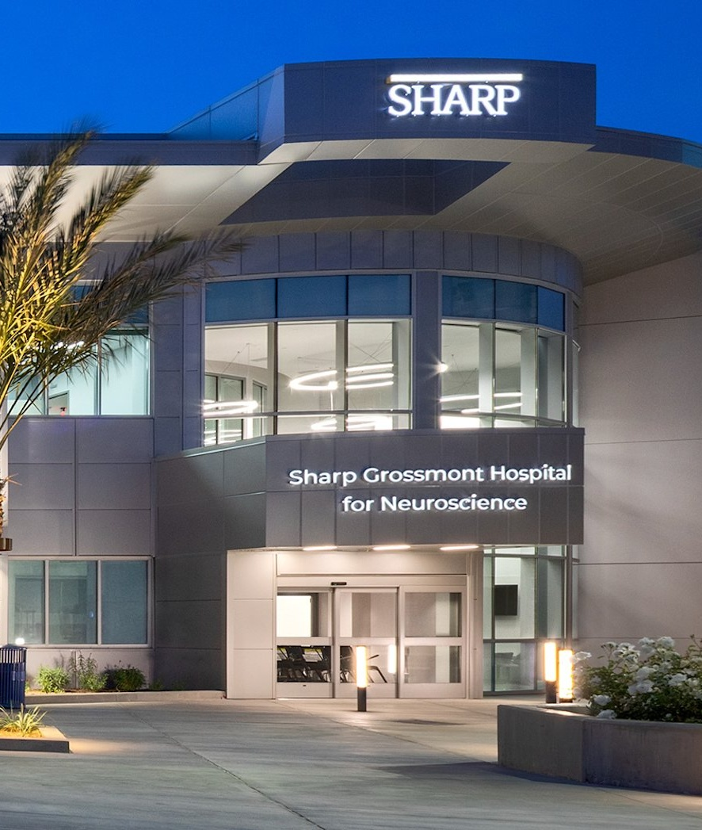
Sharp Grossmont Hospital
for Neuroscience
The Sharp Grossmont Hospital for Neuroscience, San Diego’s first comprehensive specialty hospital of its kind, is transforming the future of neurological care with compassionate and innovative treatments for brain, nerve and spine conditions.
With 16 Neuro-ICU, 16 Neuro-PCU, and 18 Inpatient Rehabilitation beds, rehab gym, and an outpatient neuroscience specialty clinic on its second floor, this hospital is a testament to Sharp Grossmont Hospital’s commitment to providing cutting edge care to East County San Diego and beyond.

Slide 17

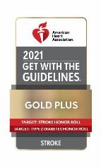

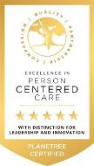
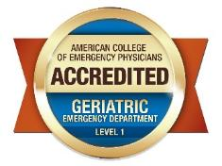
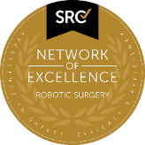

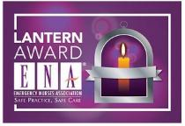
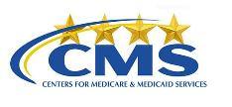
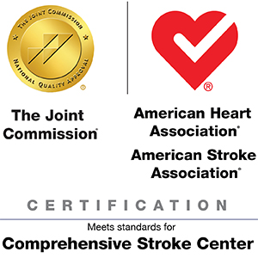
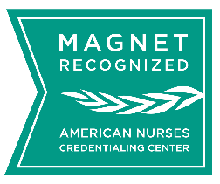

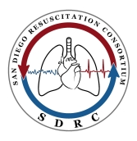
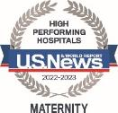





“We are what we repeatedly do. Excellence, therefore, is not an act, but a habit.” -Aristotle
Notes:
Source:
2024 Sharp Grossmont Hospital Market Assessment
SGH Quality and Patient Safety Department
SGH Insight Center
SGH Marketing Department
Sharp HealthCare Editorial Style Guide (SHC physicians, employees, volunteers; accessed via sharpnet.sharp.com 10/31/2024)
2024 SGH Market Assessment (SHC population served, accessed 10/31/2024)
2022 Sharp HealthCare Community Health Needs Assessment
Sharp Marketing
Sharp HealthCare Credentialing Department

